Slide 1


Day 27
contact@anubhavtrainings.com
ABAP RESTFUL APPLICATION PROGRAMMING

Slide 2

Agenda – Day 27
Introduction to Managed Scenario
Use Case for Managed Scenario
Describing Functionality of Scenario
End to End Development Flow
Create Base CDS Views

Slide 3
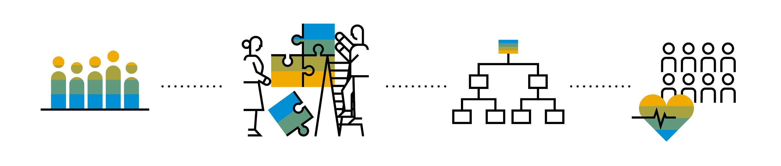
Introduction to Managed Scenario
Let us consider we have been given a green field and asked us to develop a villa from scratch with our own customization. So, what steps will be involved in it? We need to design the floor-plan of the villa, the sections we want to include in the house like pool area, a garden, a jogging track etc. And we will proceed with selecting materials, selecting vendors, enforcing conciliation and orders and many more steps. Similarly, the RAP’s managed scenario provides the greenfield development for our business object.
In the managed scenario, the implementations of behavioral elements like Create/Update/Delete are managed by the RAP framework itself. However, to implement complex logic like validations, determination or some sort of actions (Submit, Approval, Reject etc.) on the business entity, you need to add the ABAP logic for it in implementing classes.

Slide 4
Use Case for Managed Scenario
I am working as a ABAP on Cloud developer for one of the Multi-nationals, which has just taken the SCP subscription. They want me to create 2 fiori apps for the travel industry
Processor Application
Approver Application
MakeMyTrip.com
Source → Destination
Start → End Date
How many
Travel Itinerary
Travel Request which has multiple Bookings
Create a travel request and add bookings with all the properties changeable
Booking fee
Description
Give approval
Processor
Approver

Slide 5

Steps for Build Use Case
Fiori App for Processor
Fiori App for Approver
Service Def and Binding
Service Def and Binding
1
3
CDS Data Model
CDS Projection for Processor @UI
CDS Data Model
CDS Data Model
CDS Projection for Approve @UI
Introduction
1..1
2
Behavior Def
Behavior definition
Behavior definition
Behavior Def
Behavior definition
Behavior Implement (pool)

Slide 6
End to End Development Flow
4. Imp Behavior Definition on top of Projection View’s of Processor App.
7. Imp Behavior Definition on top of Projection View’s of Approver App.
2. Imp Behavior Definition on Travel.
6. Create Service Binding on top of Service Definition.
10. Create Service Binding on top of Service Definition .
1
3
5
7
9
2
4
6
8
10
1. Create Basic CDS View’s
For Travel & Booking.
3. Create Projection CDS on top of Basic View’s for Processor App.
5. Create Service Definition for Processor App.
7. Create Projection CDS on top of Basic View’s for Approver App.
9. Create Service Definition for Approver App.

Slide 7
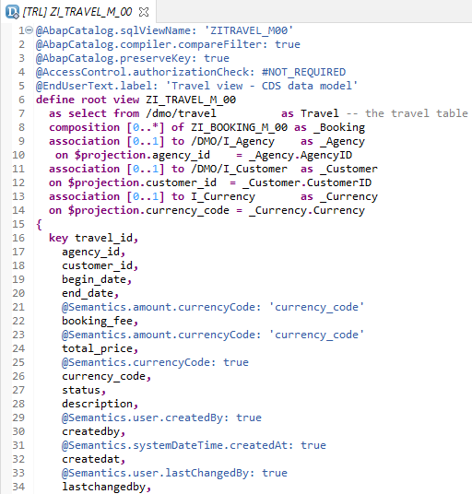
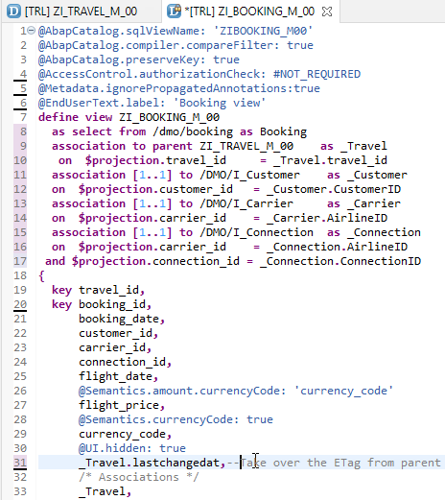
Create Base CDS View
ZI_TRAVEL_M_00
ZI_BOOKING_M_00

Slide 8

End of Day 27
Trainer: Anubhav Oberoy

Slide 9

Trainer: Anubhav Oberoy

Slide 10
THANK YOU
If you cannot do
great things, do small things in a great way.
Anubhav Oberoy
https://www.anubhavtrainings.com

Slide 11


We’re committed to empower you to be
Most Desirable Resource
through powerful training solutions.
We build the workforce of the future.
250+
Corporate Clients
30,000+
Learners Trained
25000+
Learners Placed
FREE WEBINARS
Sign up for free webinars with industry experts every fortnight!
Enroll Now!
Contact us today!
https://anubhavtrainings.com/

Slide 12




More from AnubhavTrainings.com

